Slide 1
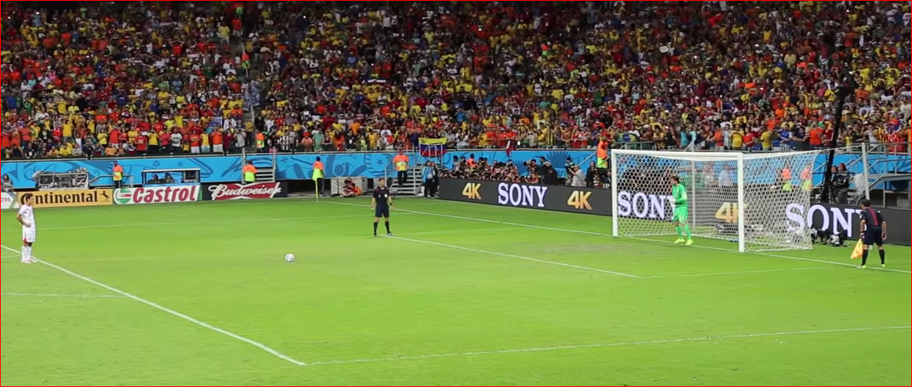
Taking of Kicks From the Penalty Mark
Updated August 2019

Slide 2
Taking of Kicks From the Penalty Mark

Slide 3
Taking of Kicks From the Penalty Mark
The kicks from the penalty mark are not part of the game.
- the kicks from the penalty mark phase begins immediately when the whistle signals the end of regulation play (plus any required or additional time.)
Unless otherwise stated, the relevant laws of the game and international F.A. Board Decisions apply when kicks from the penalty mark begin.

Slide 4
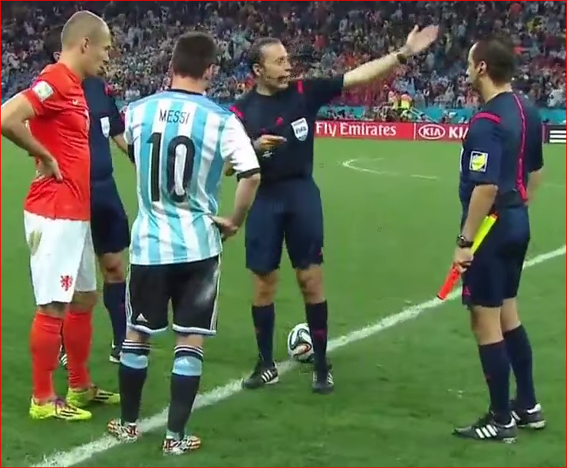
Taking of Kicks From the Penalty Mark
The referee tosses a coin to choose the goal at which the kicks will be taken:
- exception – if there are other considerations (eg safety).
- the goal may be changed only if it becomes unusable/safety.
The referee tosses the coin again the team whose captain wins the toss decides whether to take the first or the second kick.

Slide 5
Taking of Kicks From the Penalty Mark
Each kick is taken by a different player and all eligible players must take a kick. Eligible players are the players on the field at the end of the match (injured GK excepted)
Once all eligible players have taken a kick from the penalty mark only then can an eligible player take a second kick from the penalty mark (a new order is allowed)
Only the eligible players, the referee, and both assistant referees are allowed on the field of play when kicks from the penalty mark are being taken. The fourth official is to remain in their position and look after the technical areas.

Slide 6
Taking of Kicks From the Penalty Mark
All the officials are to keep a record of the game. Do NOT ask for a list of order of kickers – this is not allowed

Slide 7
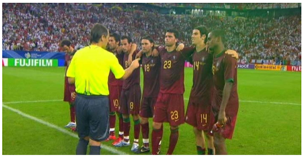
Taking of Kicks From the Penalty Mark
Before the start of the kicks from the penalty mark, the referee shall ensure that an equal number of players from each team remain within the centre circle and they shall take the kicks.

Slide 8
Taking of Kicks From the Penalty Mark
When a team finishes the match with a greater number of players then their opponents, they shall reduce their numbers to equal that of their opponents.
The referee will be informed of the names and numbers of each player excluded.
The team captain has this responsibility of informing the referee.

Slide 9
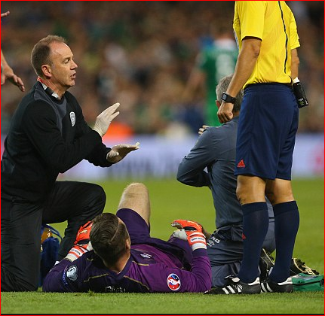
Taking of Kicks From the Penalty Mark
If a goalkeeper is injured while the kicks are being taken from the penalty mark and is unable to continue as a goalkeeper, he may be replaced by a named substitute provided that his team has not used the maximum number of substitutes permitted under the competition rules. The substituted GK cannot kick until the next round if the GK has already kicked.
A GK can be replaced by another eligible player (i.e. a kicker) at any time, or
an excluded player if the GK cannot continue.
With the exception of the foregoing
case, only players who were on the
field of play at the end of the match,
which includes extra time where
appropriate, are allowed to take
kicks from the penalty mark OR act as goalkeeper

Slide 10
Taking of Kicks From the Penalty Mark

Slide 11
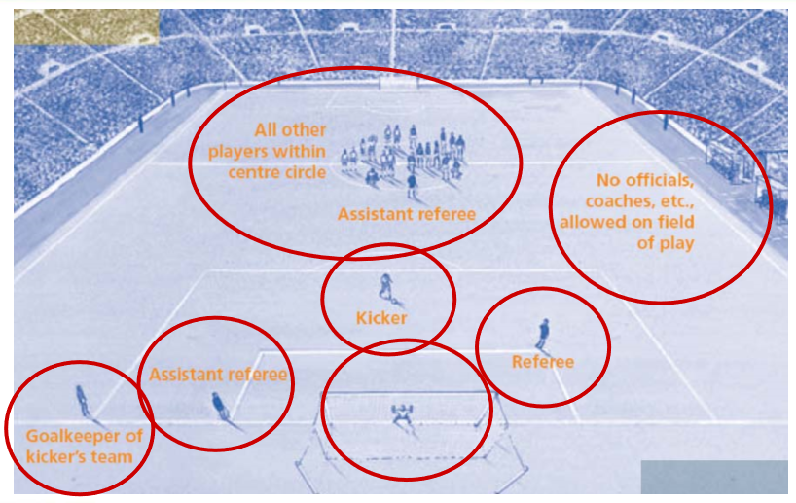
Taking of Kicks From the Penalty Mark
Positioning

Slide 12
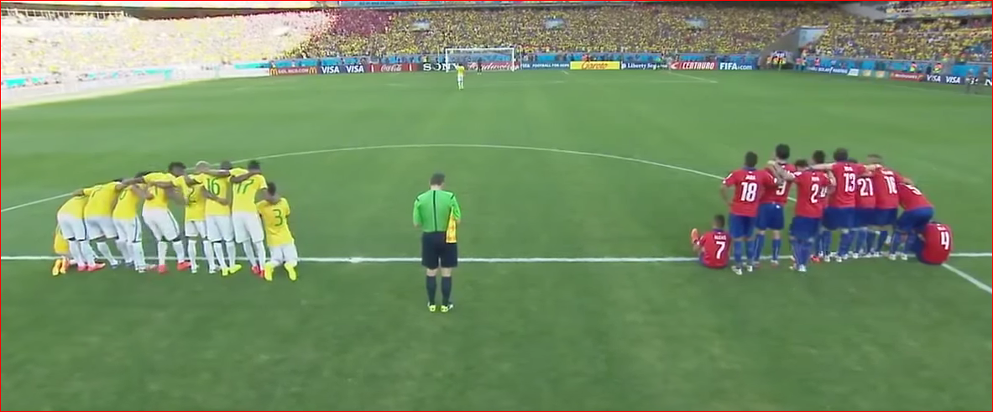
Taking of Kicks From the Penalty Mark
All eligible players, except the player taking the kick and the two goalkeepers, must remain within the centre circle. Only eligible players may be on the field of play.

Slide 13
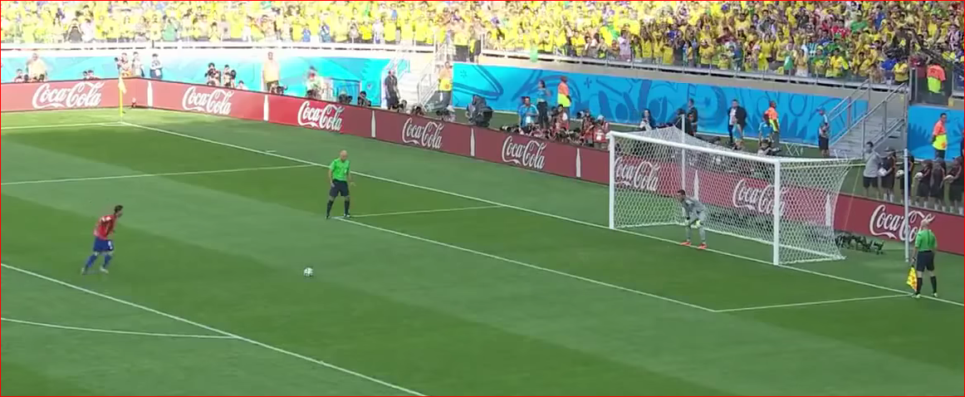
Taking of Kicks From the Penalty Mark
The goalkeeper who is the team-mate of the kicker must remain on the field of play, outside the penalty area in which the kicks are being taken, on the goal line where it meets the penalty area boundary line.

Slide 14
Taking of Kicks From the Penalty Mark
• The kick is completed when the:
Ball stops moving,
Ball goes out of play or
Referee stops play for any offence;
The kicker may not play the ball a second time

Slide 15
Taking of Kicks From the Penalty Mark
• The referee keeps a record of the kicks

Slide 16
Taking of Kicks From the Penalty Mark
• If the goalkeeper commits an offence and, as a result, the kick is retaken, the goalkeeper must be cautioned.
• If the kicker is penalised for an offence committed after the referee has signalled for the kick to be taken, that kick is recorded as missed and the kicker is cautioned.
• If both the goalkeeper and kicker commit an offence at the same time:
if the kick is missed or saved, the kick is retaken and both players are cautioned
if the kick is scored, the goal is disallowed, the kick is recorded as missed and the kicker cautioned

Slide 17
Taking of Kicks From the Penalty Mark
Offender | Outcome of Kick | Result of Kick | Caution?
GK | Missed or Saved | Retake | YC to GK
Kicker | N/A (any offence after signal) | Marked as Missed | YC to Kicker
GK + Kicker | Missed or Saved | Retake | YC to Both
GK + Kicker | Scored | Marked as Missed | YC to Kicker
GK Offences Encroachment from goal-line Any other cautionable offence
Kicker Offences Illegal Feinting at point of kick Wrong kicker Ball kicked Backwards Any other cautionable offence

Slide 18
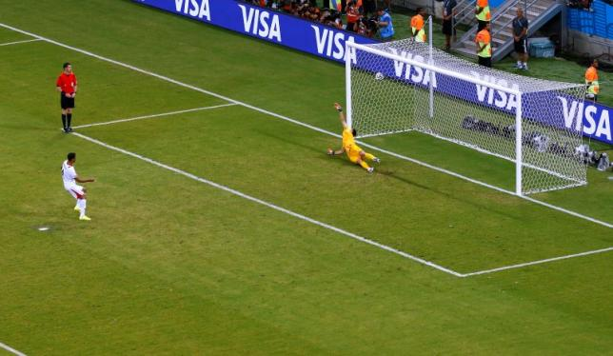
Taking of Kicks From the Penalty Mark
Subject to the conditions explained below, both teams take 5 kicks.
The kicks are taken alternately by the teams.

Slide 19
Taking of Kicks From the Penalty Mark
If before both teams have taken an equal number of kicks each, and one team has scored more goals than the other team can score, even if it were to complete its five kicks, no more kicks are taken. (0-3), (1-4), (2-4)
-The procedure stops.
If after both teams have taken five kicks each and both teams have scored the same number of goals, or have not scored any goals, the kicks will continue to be taken one at the time, and alternatively, until one team has scored a goal more than the other from the same number of kicks. New kickers continue to be used until all eligible players have kicked, including GoalKeepers

Slide 20
Taking of Kicks From the Penalty Mark
A player, other than the goalkeeper, cannot be substituted if they are injured during the taking of kicks from the penalty mark.
An eligible player may change places with the goalkeeper at any time when kicks from the penalty mark are being taken, if the referee is informed.
If the goalkeeper is sent off during the taking of kicks from the penalty mark, he shall be replaced only by an eligible player that finished the match.

Slide 21
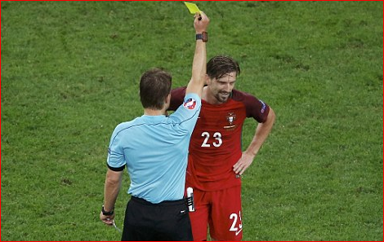
Taking of Kicks From the Penalty Mark
A player, substituted player or a substitute can be cautioned or sent off during the taking of kicks from the penalty mark.
The referee will NOT stop the
procedure if a team remains
with less then seven players
during the taking of kicks
from the penalty mark.

Slide 22
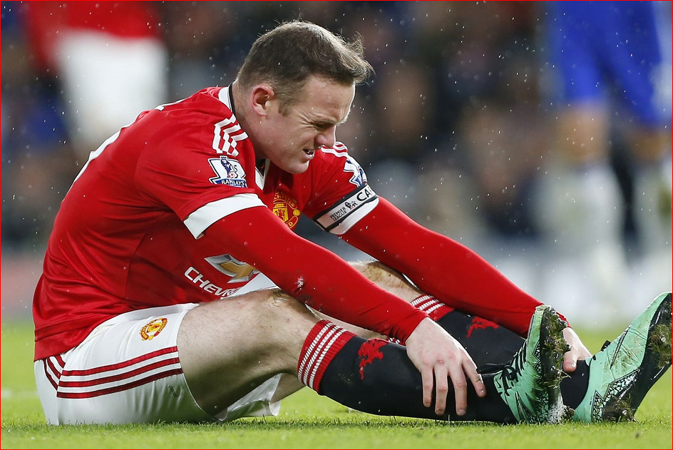
Taking of Kicks From the Penalty Mark
If a player is injured or sent off during the taking of kicks from the penalty mark, and the team has one player less,
the referee should reduce the number of players taking kicks for the other team.
An equal number of players
from each team is
required at the start and during
the taking of kicks from
the penalty mark procedure.

Slide 23
Taking of Kicks From the Penalty Mark
Additional guidance and clarification:
At the taking of a penalty during normal play an assistant may raise the flag if the goal keeper moves forward of the goal line before the ball is in play. The referee may amend this in the pre-match instruction.
(Taking a penalty kick during normal time the referee has to look out for encroachments and relies on the assistant to inform him if the keeper moves forward.)
When kicks from the penalty mark are used to determine the winner of the match, the assistant acts as a goal judge only.
(During the kicks from the penalty mark procedure, encroachment cannot take place so the referee is able to keep an eye on the keeper moving forward.)

Slide 24
Taking of Kicks From the Penalty Mark
Tips and Tricks:
Take the players number before they kick – if using comms have the AR in the centre circle confirm the number as the player walks to the mark
Once a team can no longer beat the other, the kicks cease – keep an eye on this.
Before kicks commence, the 4th official or AR1 should remind the coaches that substitutions need to occur before full time for players to be eligible for KFTPM.
The referee has a different position and responsibility for KFTPM – it is the referee who determines if the GK has infringed.

