Slide 1
Laws of the Game 2018/19 Summary of Law Changes

Slide 2
Presentation Outline
Recap of 2018 Laws of the Game, (LOTG)
LOTG Summary
Changes applicable to State League Competitions
Examples
Notes:
Presentation Outline
Recap of 2018 Laws of the Game, (LOTG)
LOTG Summary
Changes applicable to State League Competitions
Examples

Slide 3
Recap on laws from 2018
Notes:
LOTG 2018 Recap
Respect for referees even if it appears the decision is wrong
Drinks break permitted at half time in extra time (Not meant for coaching)
Player in an offside position who interferers or (blocks) a defender is penalised
Player stopping a promising attack, (SPA) in the penalty are is not cautioned, (YC) if attempting to play the ball.
Keeper who causes a kick from the penalty mark to be retaken will be cautioned, (YC)

Slide 4
LOTG 2018 Recap
Respect for referees even if it appears the decision is wrong
Drinks break permitted at half time in extra time (Not meant for coaching)
Player in an offside position who interferers or (blocks) a defender is penalised
Player stopping a promising attack, (SPA) in the penalty are is not cautioned, (YC) if attempting to play the ball.
Keeper who causes a kick from the penalty mark to be retaken will be cautioned, (YC)
Notes:
LOTG 2018 Recap
Respect for referees even if it appears the decision is wrong
Drinks break permitted at half time in extra time (Not meant for coaching)
Player in an offside position who interferers or (blocks) a defender is penalised
Player stopping a promising attack, (SPA) in the penalty are is not cautioned, (YC) if attempting to play the ball.
Keeper who causes a kick from the penalty mark to be retaken will be cautioned, (YC)
LOTG 2018 Recap
Respect for referees even if it appears the decision is wrong
Drinks break permitted at half time in extra time (Not meant for coaching)
Player in an offside position who interferers or (blocks) a defender is penalised
Player stopping a promising attack, (SPA) in the penalty are is not cautioned, (YC) if attempting to play the ball.
Keeper who causes a kick from the penalty mark to be retaken will be cautioned, (YC)

Slide 5
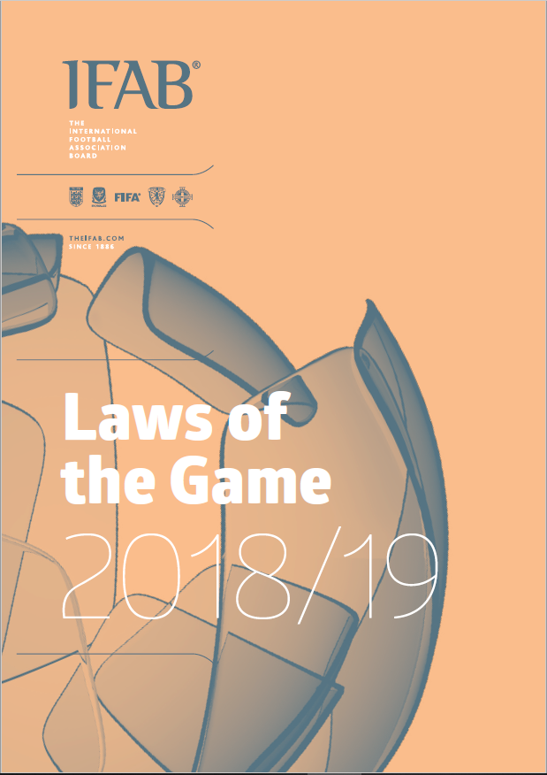
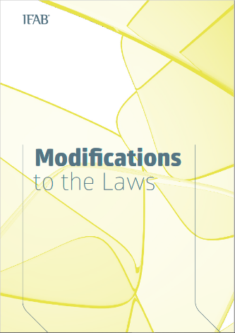
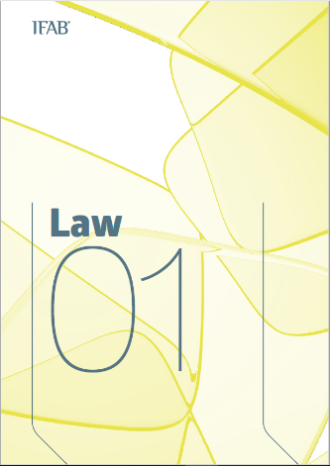
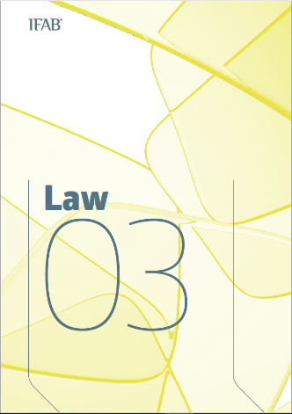
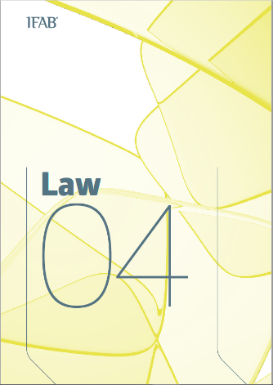
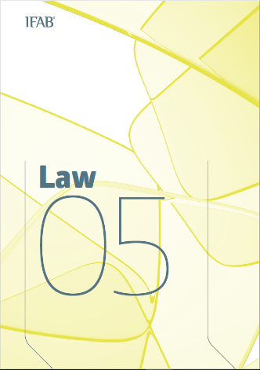
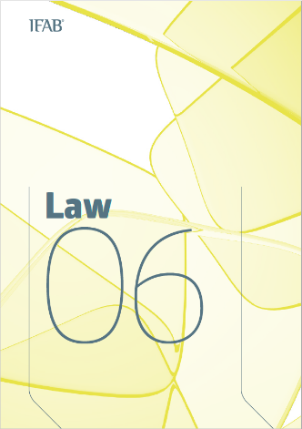
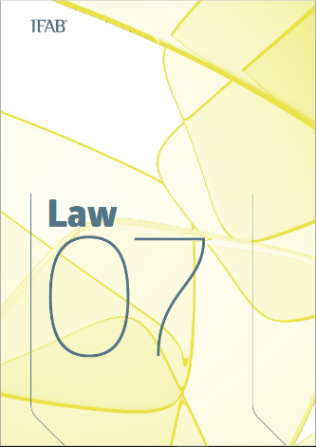
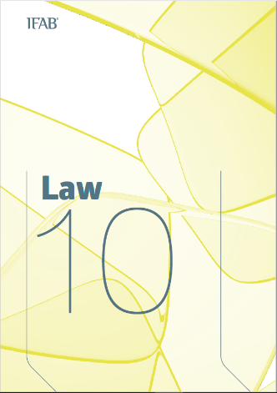
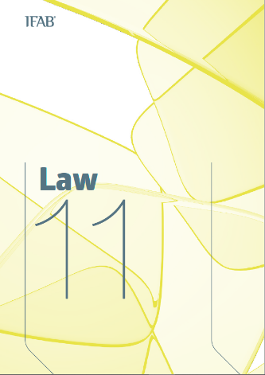
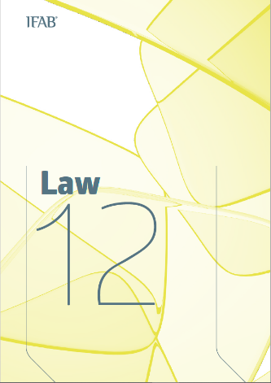
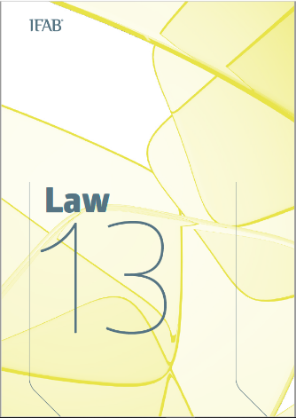
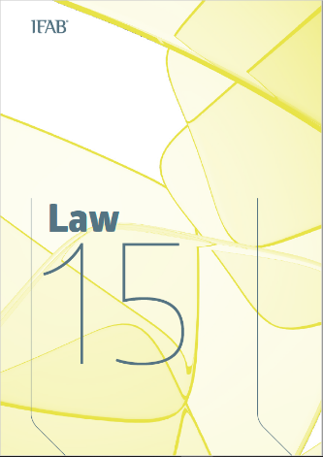
Notes:
2018-19 LOTG
Modifications, (additional text) or Changes
Applicable to eleven laws - 1, 3, 4, 5, 6, 7, 10, 12, 11, 13, 15
Not all changes are applicable to the NSW State League competitions like the Video Referee and it protocols. Won’t cover these.
Referees on the National panel have already been briefed the changes
If your interested in all the LOTG changes, read in your own time

Slide 6
Law 1 - The Field of Play
Reference to the Video Operation Room (VOR) and Referee Review Area (RRA)
Commercial advertising is not permitted on the ground in the Referee Review Area (RRA]
Substituted players are now referred to in the technical area.
Notes:
Law 1
Additional text clarifying where the field marks are measured from.

Slide 7
Law 3 - The Players
Notes:
Law 3
Additional text

Slide 8
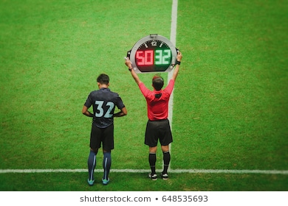
Law 3 - The Players
Competition rules may allow an additional substitute in extra time (even if 3 permitted substitutes have been used)
A maximum of 12 substitutes can be named for international 'A' friendly matches of which only 6 may be used.
Notes:
Law 3
Competition rules may allow an additional substitute in extra time (even if 3 permitted substitutes have been used)
A maximum of 12 substitutes can be named for international 'A' friendly matches of which only 6 may be used.
This wont apply to our competition, however it may be used for semi finals, finals and special competitions.
FNSW will advise if an additional substitute in extra time is to be applied.

Slide 9
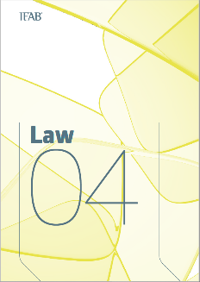
Outline of the main changes/clarification 2018/19
Law 4 – The Players’ Equipment
Small hand-held electronic or communication devices are permitted in the TA if used for coaching/tactics or player welfare
EPTS quality mark
Detailed guidelines for what can and cannot appear on players’ equipment. Players can be penalised for Slogans, advertising or images on shirts or equipment. This may be penalised under Law 12 if abusive or insulting.
Player who returns without permission and interferes DFK.
Notes:
Law 4
Small hand-held electronic or communication devices permitted in the TA if used for coaching/tactics or player welfare
e.g. - Headphone, mobile phone, tablet
Details - (IFAB LOTG Pg 57)
Slogans, advertising or images – confined to the teams shirtfront or arm band.
Interpreting the law, refer to Law 12. (IFAB LOTG Pg 59)
Read the list (IFAB LOTG Pg 59)
Player returns without permissions is now a DFK not IFK.

Slide 10
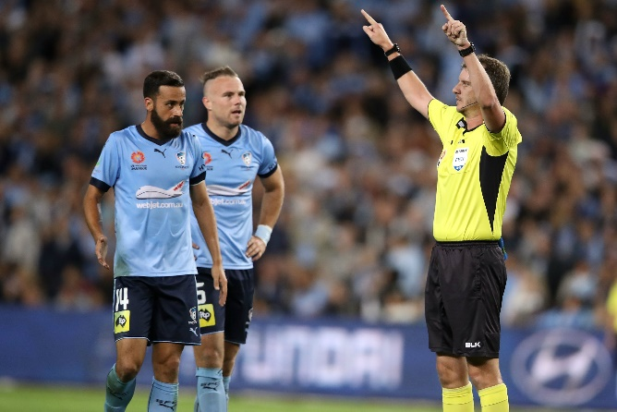
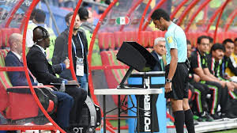
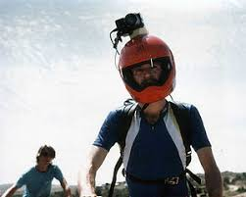
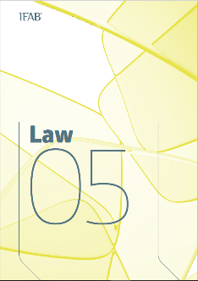
Outline of the main changes/clarification 2018/19
Law 5 – The Referee
VAR / AVAR
Goal/No Goal
Penalty
RC offences
Mistaken Identity
Match officials are not permitted to wear cameras
Notes:
Law 5
Edition to on-field officials not wearing jewellery, cannot wear cameras added

Slide 11
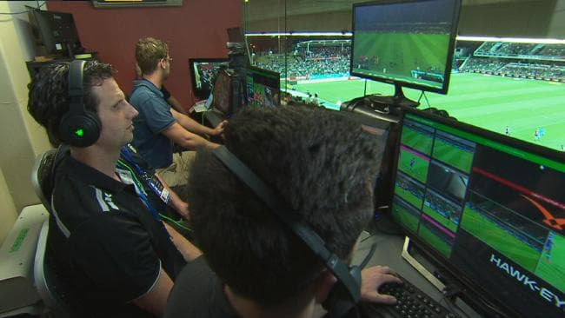
Outline of the main changes/clarification 2018/19
Law 6 – The Other Match Officials
Duties of VAR and AVAR
Notes:
Law 6
Outlines the duties of the Video Assist Referee and assistant Video Assist Referee
As seen in A-League this year
Following clip demonstrates how the VAR has made a positive influence to the game

Slide 13
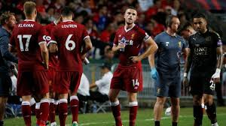
Law 7 -The Duration of the Match
Drinks breaks should not exceed one minute (this does not apply to approved medical 'cooling' breaks)
A short drinks break is permitted at half time during extra time. This must not exceed 1 minute.
Allowance must be made for time 'lost' for drinks breaks and VAR checks/reviews
Notes:
Law 7
Medical cooling breaks are determined by……… When temperature is……….
Added time only applicable to 1st grade fixtures
U18’s & 20’s need to manage playing time.

Slide 14
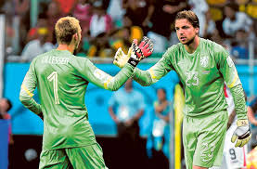
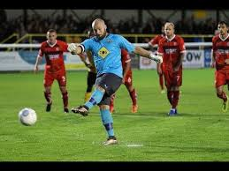
Law 10 - Determining the Outcome of a Match
Kicks taken from the Penalty mark
A replacement for a goalkeeper can not take a kick in that 'round' if the original goalkeeper has already taken a kick
Notes:
Law 10
Kicks from the penalty mark can only be taken by the replacement keeper if the original keeper has not already taken a kick in that round.

Slide 15
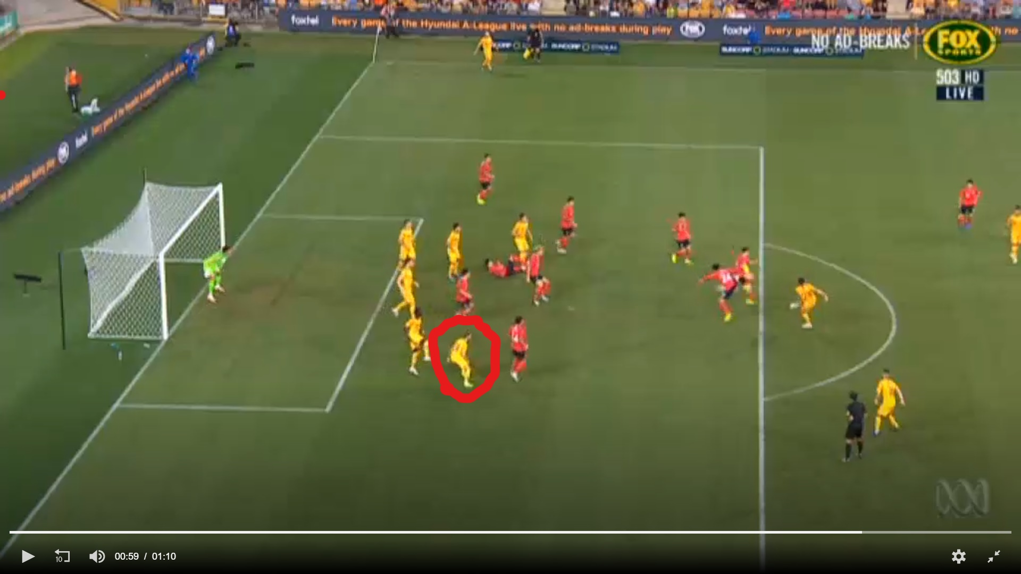
Law 11- Offside
The first point of contact with the ball when it is 'played or touched' is the moment when offside position is judged
Notes:
Law 11
The first point of contact of the play or touch of the ball should be used.
Note the player circled – Play video

Slide 16
Law 11 Offside
Notes:
Law 11
The first point of contact of the play or touch of the ball should be used.
This is where AR’s need to be diligent
Practice wait and see

Slide 17
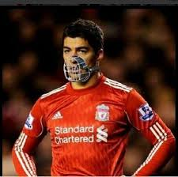
Law 12 - Fouls and Misconduct
Biting is included as a direct free kick and sending off offence
Throwing an object at the ball or hitting the ball with a held object are separate direct free kick offences and not a form of handball
If the ball rebounds from the goalkeeper this does not prevent the goalkeeper handling the ball a second time even if the first attempt to catch/holds the ball was deliberate
If the referee plays advantage for a DOGSO offence, the offender is cautioned (YC) whether or not a goal is scored
Notes:
Law 12
Biting added as a direct free kick and send off offence
Throwing an object or hitting the ball with a held object are now separate direct free kick offences and not a form of handball. This means a keeper can be sent off for a DOGSO offence.
If the ball rebounds from the goalkeeper this does not prevent the goalkeeper handling the ball a second time even if the first attempt to catch/holds the ball was deliberate (Pg 103)
If the referee plays advantage for a DOGSO offence, the offender is cautioned (YC) whether or not a goal is scored

Slide 18
Law 12 - Fouls and Misconduct
If a player commits an offence outside the field of play (ball in play) against someone from their own team (including a team official) it is an indirect free kick on the boundary line
Where 2 separate cautionable (YC) offences are committed in quick succession, both cautions (YCs) must be issued; same principle if one is a sending off offence
Entering the referee review area (RRA) or excessively showing the TV signal are cautionable (YC) offences
Entering the video operation room (VOR) is a sending-off (RC) offence
Notes:
Law 12
If a player commits an offence outside the field of play (ball in play) against someone from their own team (including a team official) it is an indirect free kick on the boundary line nearest to where the offence occurred.
Where 2 separate cautionable (YC) offences are committed in quick succession, both cautions (YCs) must be issued; same principle if one is a sending off offence
Its important that player management is practiced (Dissent)
2 videos for an example

Slide 19
2 cautions in close proximity

Slide 20
2 cautions in close proximity

Slide 21
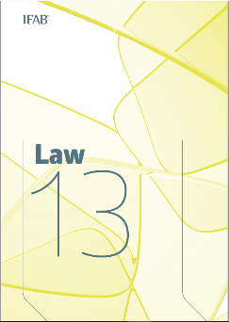
Outline of the main changes/clarification 2018/19
Law 13 – Free Kicks
Clarification FK can be awarded for offences by a substitute, substituted or sent off player or team official
Notes:
Law 13
Clarification FK (Direct or Indirect) can be awarded for offences by a substitute, substituted or sent off player or team official

Slide 22
Law 15 -Throw-in
The thrower must stand and face the field (not sit, kneel etc.) when taking a throw-in.

Slide 23
Law 12 - Fouls and Misconduct Read your LOTG book regularly “Today knowledge has power. It controls access to opportunity and advancement” Peter Drucker
THANK YOU TO CRAIG ZETTER, JIM OURLIARIS & PAUL ELDRIDGE

